Slide 1
Local Education Agency Accountability
School Year 2022-23
Rhode Island Department of Elementary and Secondary Education
Confidential Working Document Draft §RIGL 38-2-2(4)(E),(K)

Slide 2
Why Report LEA Accountability?
The Education Accountability Act of 2019*
RIGL 16-97.1-2(a)(1)
“The department shall: Provide a mechanism to review and report on the efforts of schools, charter schools, and school districts, including regional school districts, to improve the academic achievement of their students.”
RIDE has adopted a system of LEA/district accountability that is congruent to its established system of school accountability. This system meets state requirements, is aligned to the requirements of the U.S. Department of Education, and emphasizes improvement and equity.
*Mirrors Massachusetts law: MA Gen L ch 69 § 1I (2018)
Confidential Working Document Draft §RIGL 38-2-2(4)(E),(K)

Slide 3
LEA Accountability Overview
Establishes clear expectations for growth and improvement that include all students across the LEA/district.​
LEA/district Accountability is an aggregation of all students in the LEA/district. Students previously unaccounted for are now fully captured for the first time. ​
Each LEA/district has areas of strength and areas in need of improvement. This year, the system was created to highlight those areas so LEAs/districts could connect them with their strategic planning efforts and resource planning. ​
LEAs/districts will leverage funds and resources to support strategic actions articulated within the various strategic plans (LEA Strategic Plan, ESSER III Plan, Consolidated Resource Program Plan).​
Monitor LEA /district progress and performance towards targeted areas of growth and improvement for all students and student groups, including multilingual learners and differently-abled students.​
Confidential Working Document Draft §RIGL 38-2-2(4)(E),(K)

Slide 4
How do Report Cards relate to LEA accountability?
The Report Card is an online platform that displays a range of performance data for Rhode Island LEAs/districts, public schools, and charter schools. The Report Card platform includes many different kinds of data. A significant portion of the Report Card, however, is focused on accountability data. Accountability is required under federal law, and it’s also key to helping schools improve. Accountability appears as a separate tab within the Report Card platform.
While a LEA/District Report Card has existed for some time, in April 2023, this will be updated to include LEA/district ratings.
For communities, our accountability system provides details on school and LEA/district performance and empowers them to make informed decisions for their families.
NEW

Slide 5
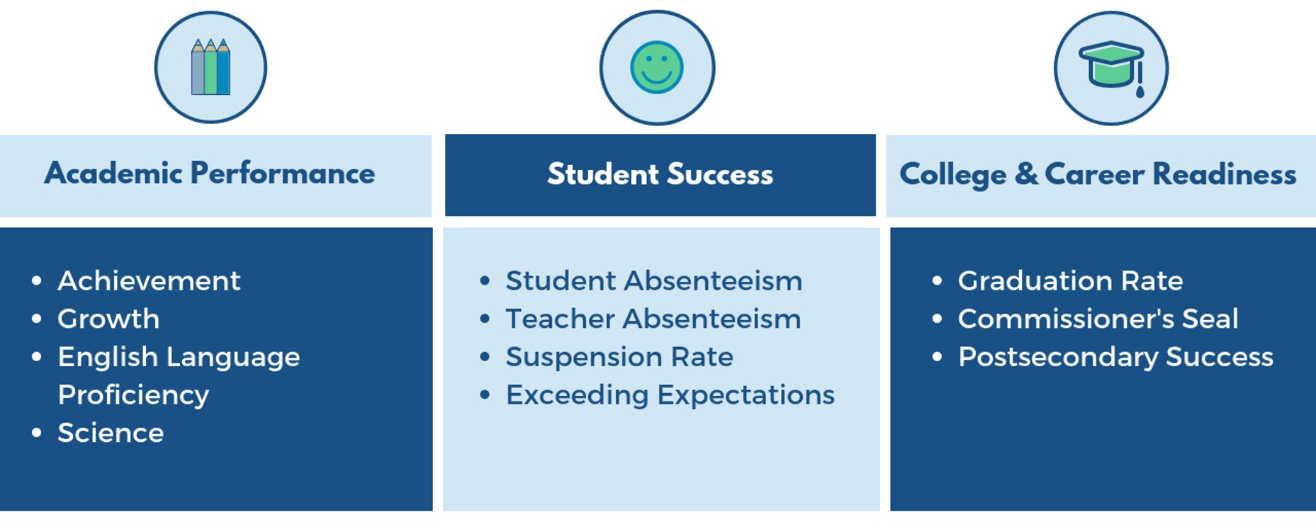
What measures do we use to evaluate LEA/district performance?​
*Science Proficiency will be added in 2023.​
Confidential Working Document Draft §RIGL 38-2-2(4)(E),(K)

Slide 6
What indicators are included in LEA Accountability?
Achievement | 2-8 points | Illustrates how students are performing on RICAS and SAT tests, and the DLM alternate assessment, in mathematics and ELA
Growth | 2-6 points | Calculated from student growth percentiles, it recognizes student progress in ELA and math as compared to their academic peers.
English Language Proficiency | 1-4 points | Measures the progress of Multilingual Learners in reaching English language proficiency. It measures the adequacy of each student’s annual progress toward proficiency. The ELP indicator represents the progress made toward each student’s annual growth target.
Graduation Rates | 1-5 points | The Composite Graduation Rate includes four-, five-, and six-year adjusted cohort graduation rates, with each of the cohort rates weighted equally. For each school or LEA, this incorporates information on three different cohorts; the graduates and number of students in each of the four-, five-, and six-year graduation cohorts for the most recent reporting year. It is important to note that in any given year, the Composite Graduation Rate is based on three different cohorts of students.

Slide 7
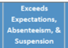
What indicators are included in the LEA Accountability (continued)?
Diploma Plus Measures | 2-6 points | The Diploma Plus measures are designed to recognize when schools better prepare students for postsecondary success by measuring two main features of preparedness: academic proficiency as determined by students earned a Commissioner’s Seal, and postsecondary credentials such as industry-recognized credentials, college credit, and Advanced Placement (scores of a 3 or higher).
School Quality and Student Success* | 5-15 points | The five measures are: ELA Exceeds Expectations, Math Exceeds Expectations, Student Suspensions, Student Chronic Absenteeism, and Teacher Chronic Absenteeism. The two Exceeds Expectations measures report the percentage of students who perform at a Level 4 on the state assessments in ELA and mathematics out of tested students who meet the requirements for accountability reporting.
*School Quality and Student Success = Exceeds Expectations, Absenteeism, & Suspension

Slide 8
Key Takeaways
The pandemic has had a severe impact on student performance and the results reflect this. ​
Specific subsets of students experienced a greater impact from the pandemic such as those that are Multilingual Learners, differently-abled, students of color, and economically disadvantaged. These challenges were evident with the number of districts where the English Language Proficiency indicator was a “focus area,” as well as the number of subgroups within districts that were low performing​
This is an opportunity for LEAs to use this data to drive their strategic planning and resource allocation efforts, capitalizing on ESSER III funds.
Confidential Working Document Draft §RIGL 38-2-2(4)(E),(K)

Slide 9
COVID-19 Academic Impact Study in Rhode Island
The National Center for the Improvement of Educational Assessment
Academic impacts seen in mathematics were larger, in general, than in ELA.
All demographic subgroups were impacted academically by the pandemic. However, there was variation in academic impact by demographic subgroups.
  Of ethnic groups, Hispanic students, overall, demonstrated the largest impacts in mathematics.
  Economically and non-economically disadvantaged students were comparably impacted in ELA whereas in mathematics, economically disadvantaged students were slightly more impacted.
  Female students demonstrated slightly more of an impact in ELA than male students. Female and male students were comparably impacted in mathematics.
Academic impacts are larger in the higher grades than in the lower grades.
Multilingual Learners demonstrated comparable academic impact to other demographic subgroups.
Confidential Working Document Draft §RIGL 38-2-2(4)(E),(K)

Slide 10
COVID-19 Academic Impact Study in Rhode Island (Continued)
The National Center for the Improvement of Educational Assessment
Academic impact for differently abled learners in grades 3 and 4 was demonstrably smaller than observed in other grades for students in special education.
  This may be indicative of special efforts directed toward that group of students to ameliorate pandemic related academic disruptions.
Examination of the results by quintile indicates greater academic impact for higher achieving students than lower achieving students in some grades, content areas and subgroups.
Examination of academic impact results for larger districts indicates all districts with some impact but with substantial variability by district.
Confidential Working Document Draft §RIGL 38-2-2(4)(E),(K)

Slide 11
State Level Trends
*Please note that each indicator may not include all LEAs due to the grade spans they serve.
Report Card Indicator | # of LEAs with Focus Areas | # of LEAs with Mid Range Performance | # of LEAs with Strong Performance
Achievement | 21 | 37 | 4
Growth | 5 | 39 | 17
English Language Proficiency | 31 | 10 | 3
Graduation Rate | 7 | 13 | 25
Diploma Plus Measure | 10 | 28 | 7
School Quality and Student Success | 5 | 39 | 18

Slide 12
District Charts
Confidential Working Document Draft §RIGL 38-2-2(4)(E),(K)

Slide 13
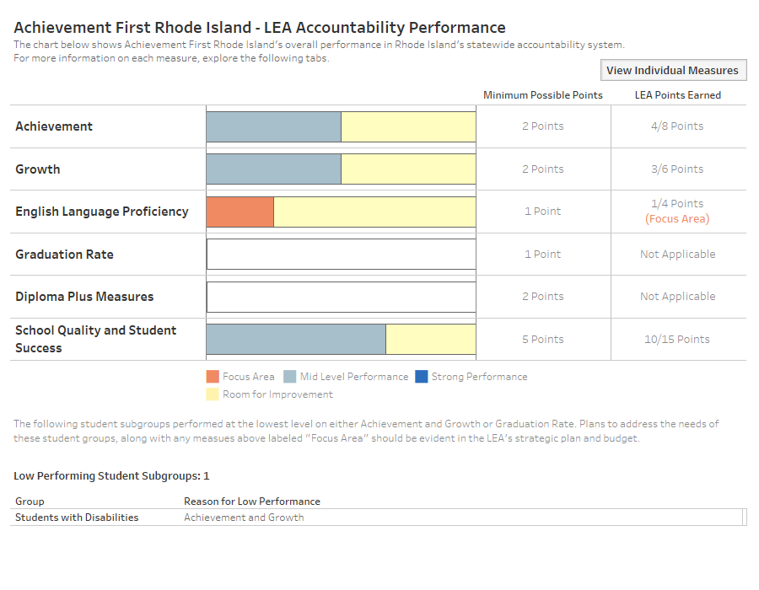
Achievement First Rhode Island
Confidential Working Document Draft §RIGL 38-2-2(4)(E),(K)

Slide 14
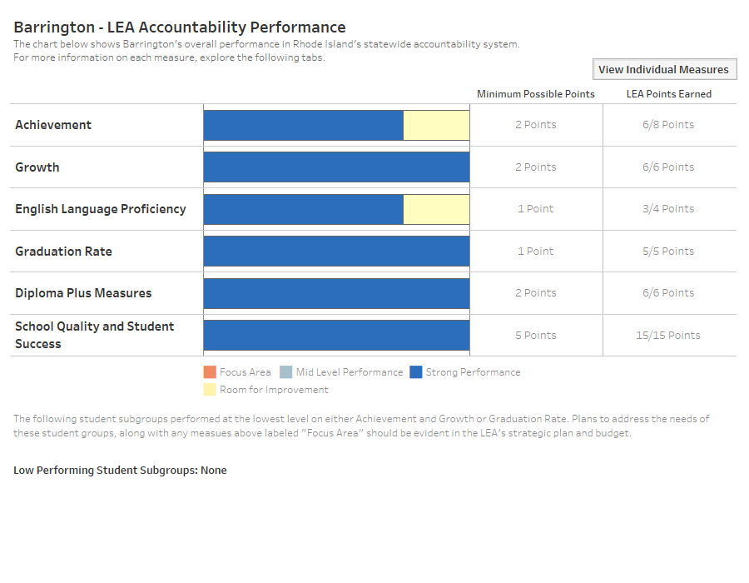
Barrington
Confidential Working Document Draft §RIGL 38-2-2(4)(E),(K)

Slide 15
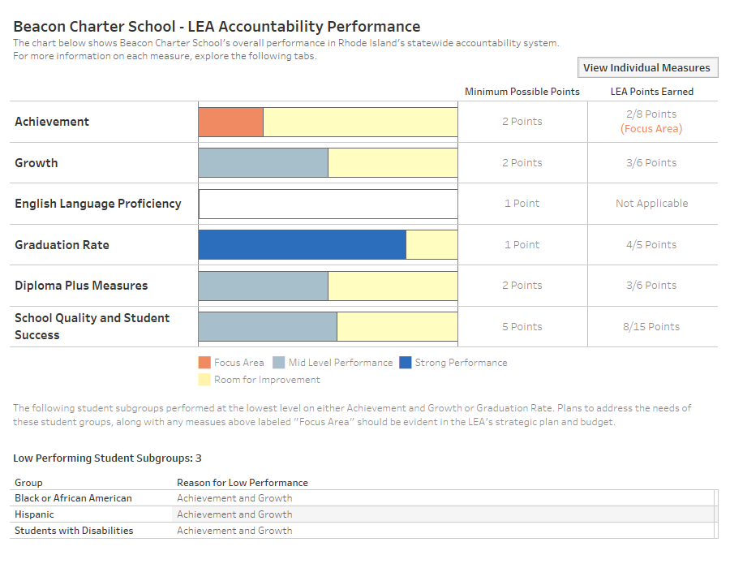
Beacon Charter School
Confidential Working Document Draft §RIGL 38-2-2(4)(E),(K)

Slide 16
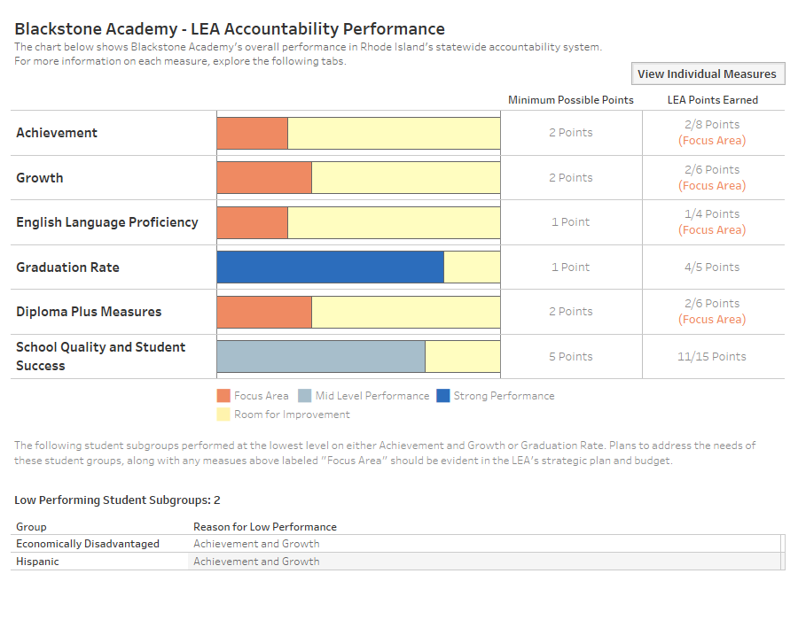
Blackstone Academy
Confidential Working Document Draft §RIGL 38-2-2(4)(E),(K)

Slide 17
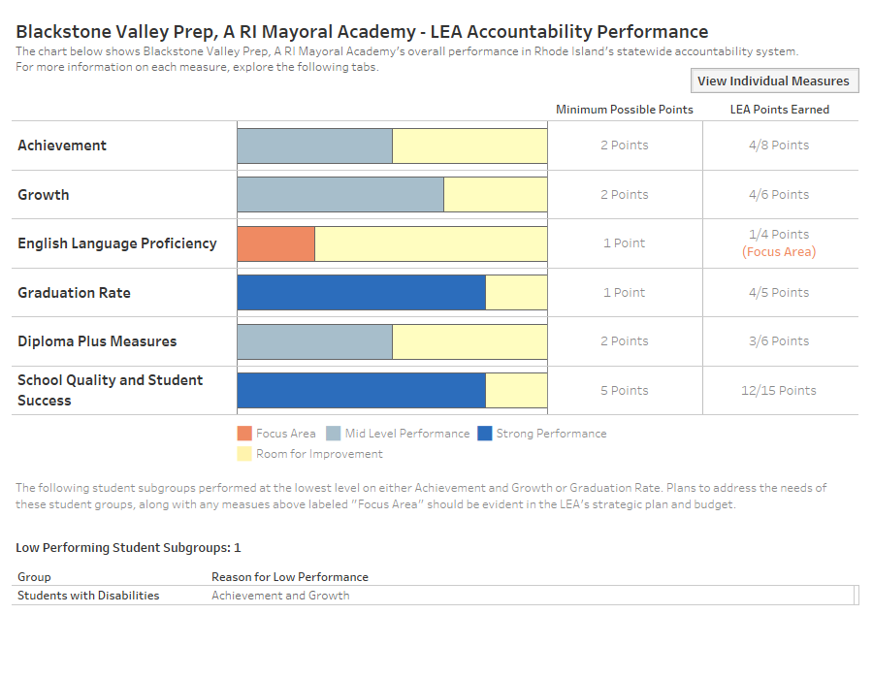
Blackstone Valley Prep, A RI Mayoral Academy
Confidential Working Document Draft §RIGL 38-2-2(4)(E),(K)

Slide 18
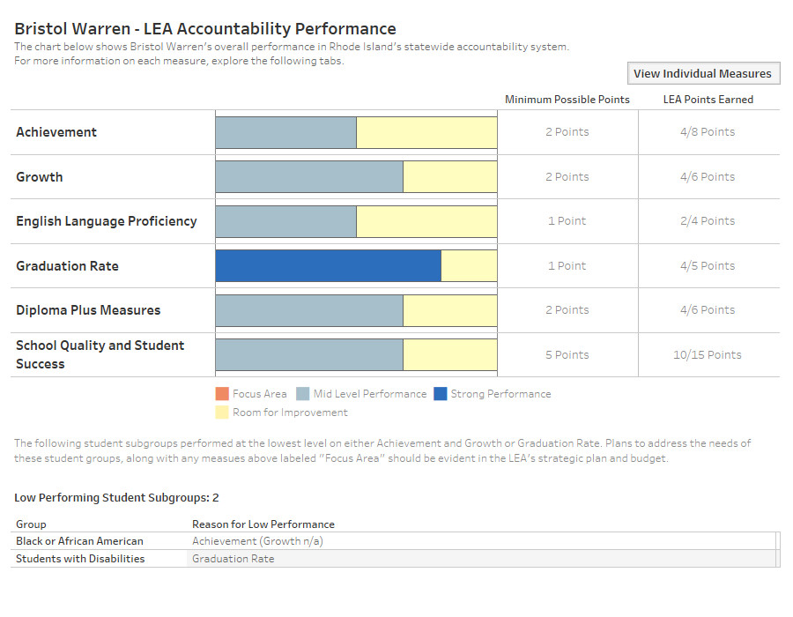
Bristol Warren
Confidential Working Document Draft §RIGL 38-2-2(4)(E),(K)

Slide 19
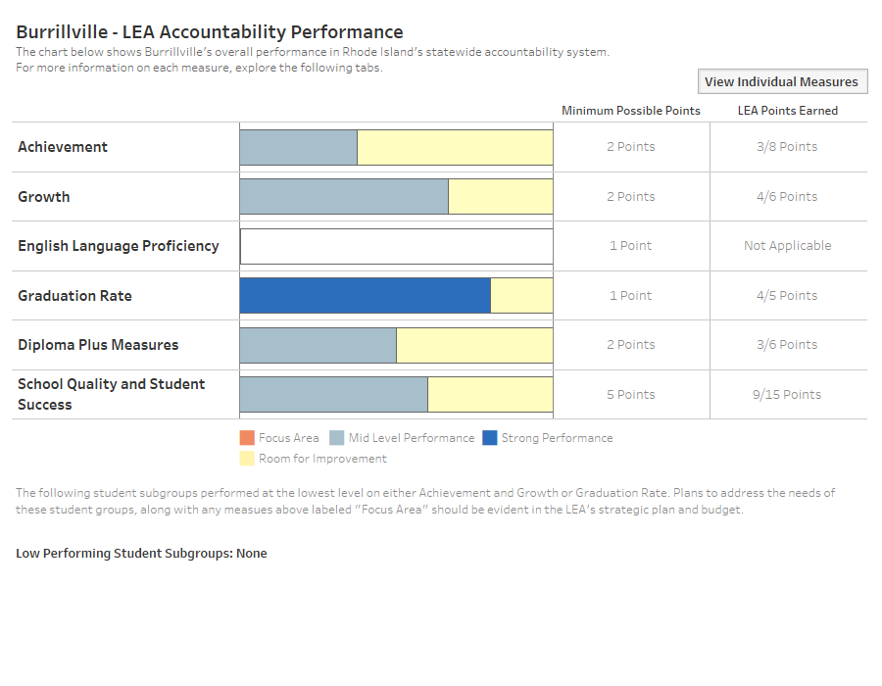
Burrillville
Confidential Working Document Draft §RIGL 38-2-2(4)(E),(K)

Slide 20
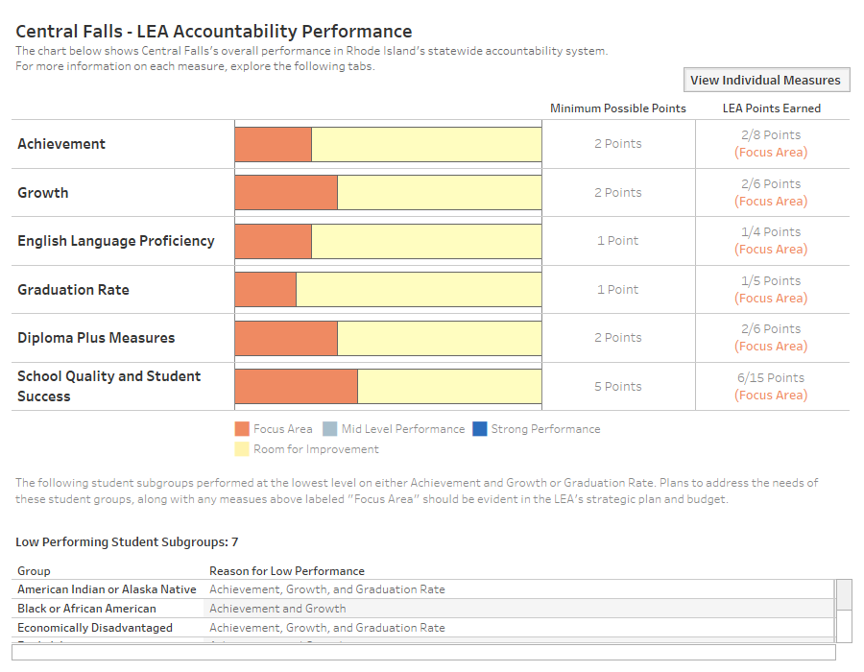
Central Falls
Confidential Working Document Draft §RIGL 38-2-2(4)(E),(K)

Slide 21
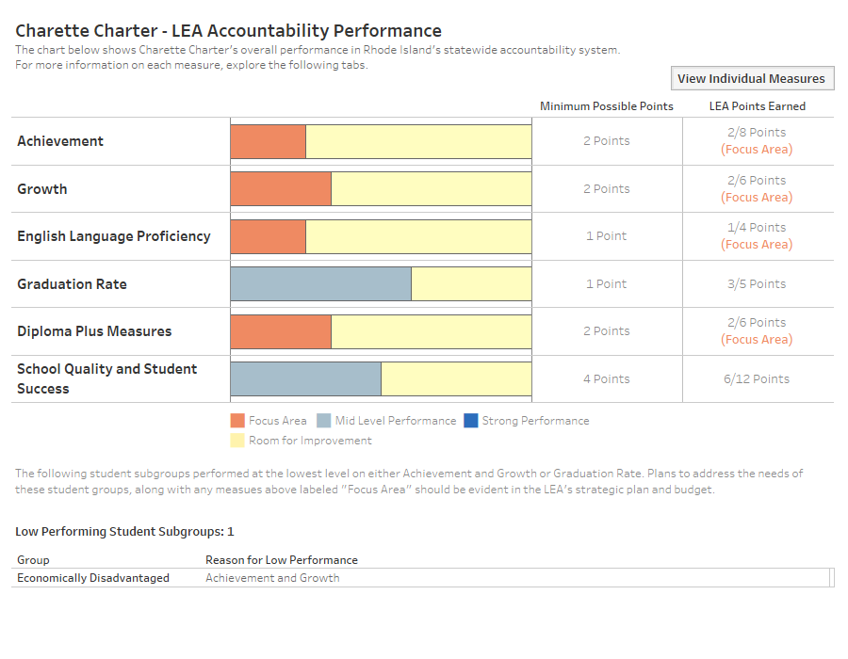
Charette Charter
Confidential Working Document Draft §RIGL 38-2-2(4)(E),(K)

Slide 22
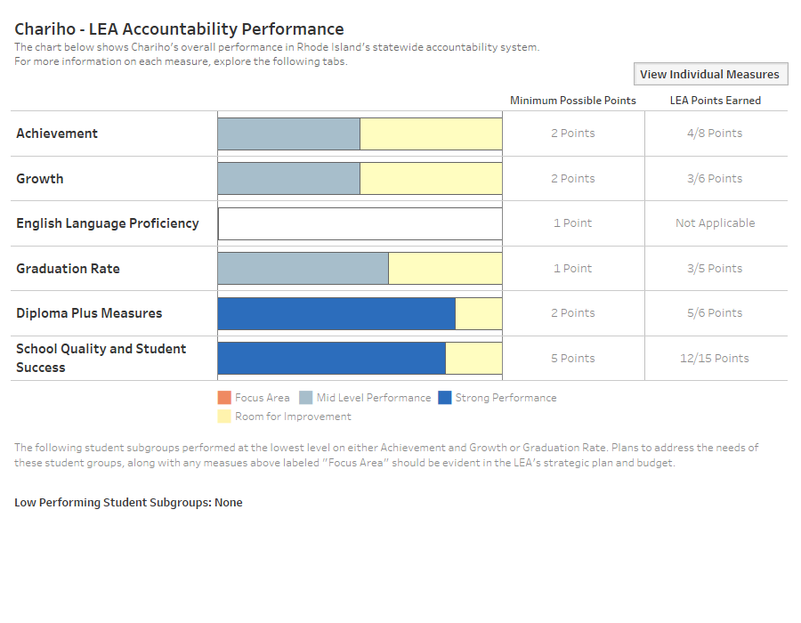
Chariho
Confidential Working Document Draft §RIGL 38-2-2(4)(E),(K)

Slide 23
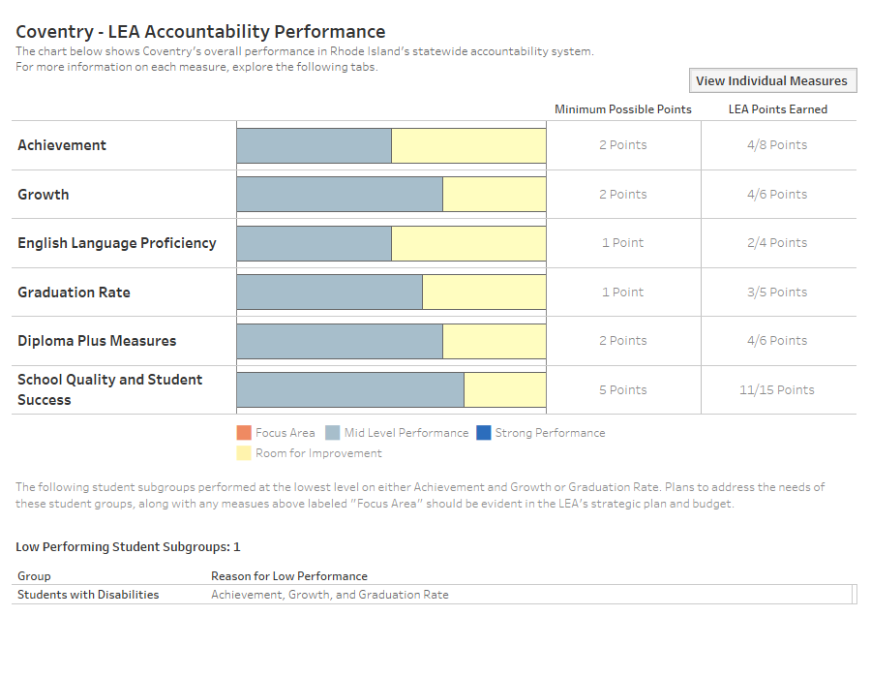
Coventry
Confidential Working Document Draft §RIGL 38-2-2(4)(E),(K)

Slide 24
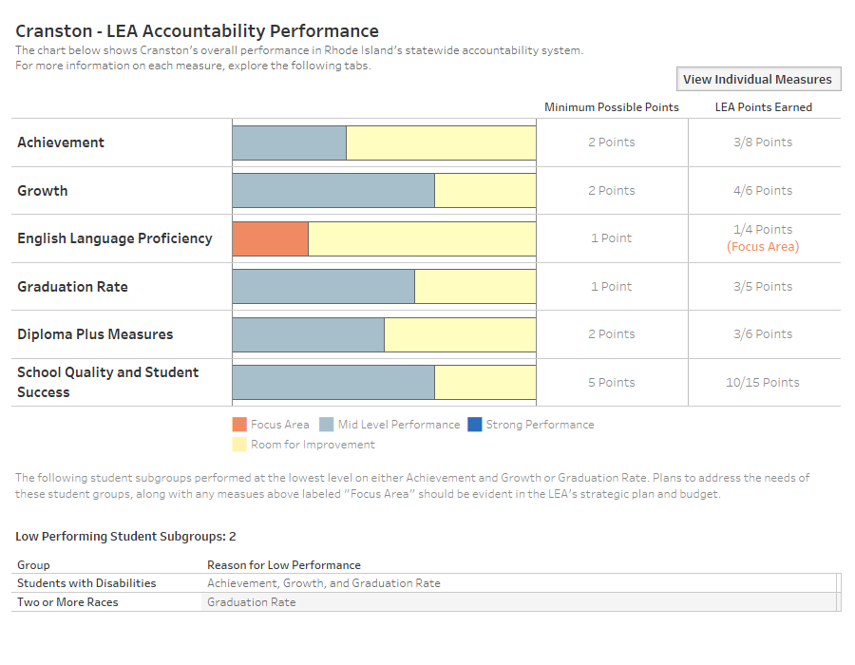
Cranston
Confidential Working Document Draft §RIGL 38-2-2(4)(E),(K)

Slide 25
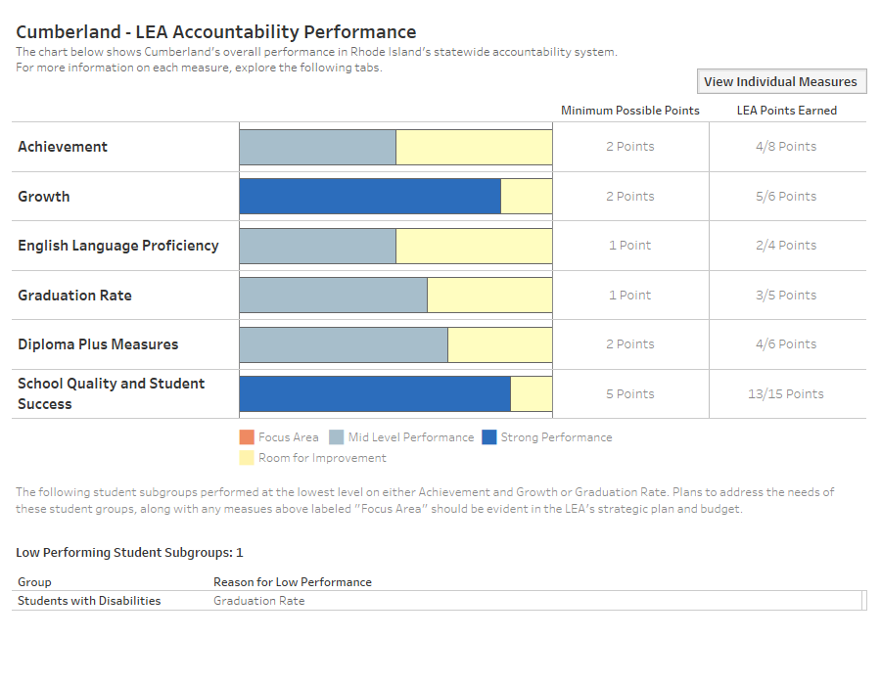
Cumberland
Confidential Working Document Draft §RIGL 38-2-2(4)(E),(K)

Slide 26
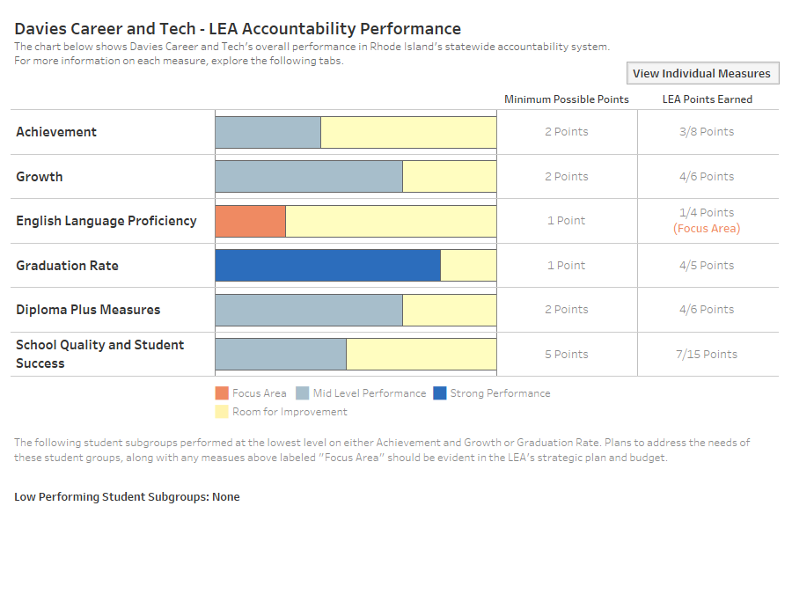
Davies Career and Tech
Confidential Working Document Draft §RIGL 38-2-2(4)(E),(K)

Slide 27
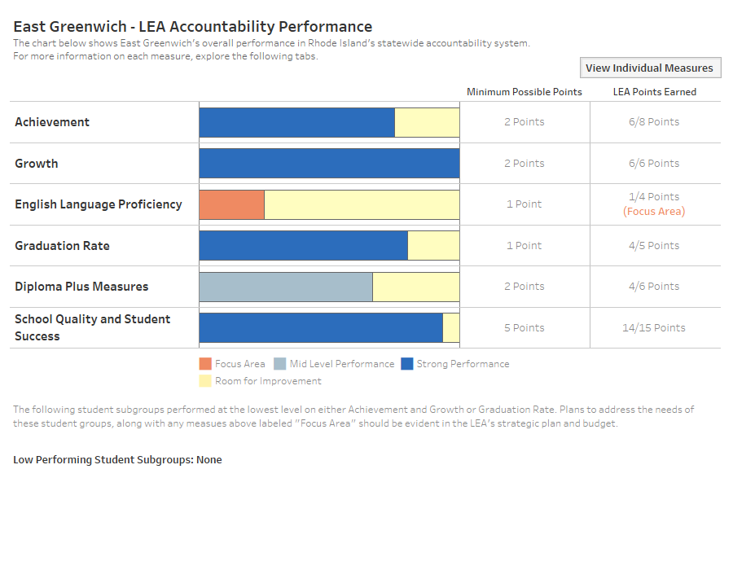
East Greenwich
Confidential Working Document Draft §RIGL 38-2-2(4)(E),(K)

Slide 28
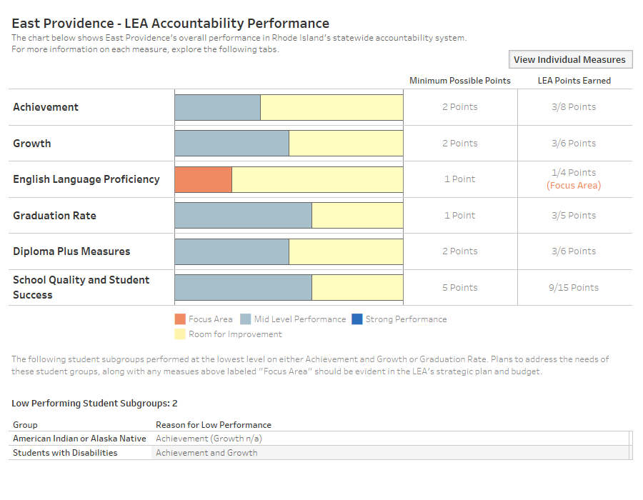
East Providence
Confidential Working Document Draft §RIGL 38-2-2(4)(E),(K)

Slide 29
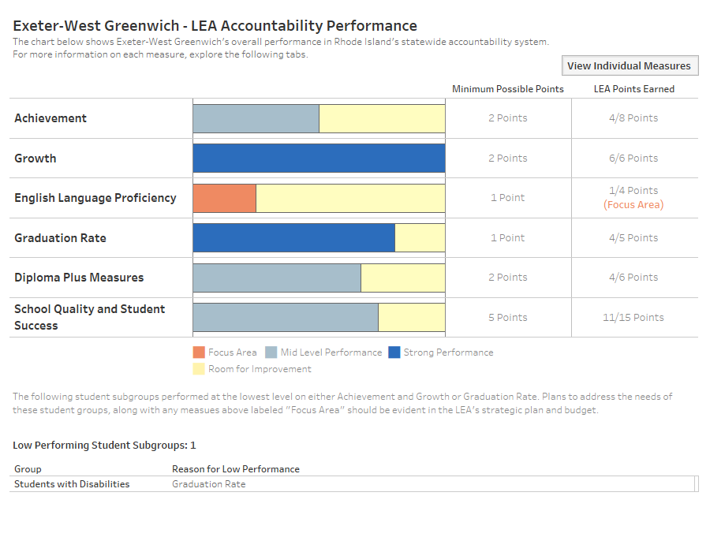
Exeter-West Greenwich
Confidential Working Document Draft §RIGL 38-2-2(4)(E),(K)

Slide 30
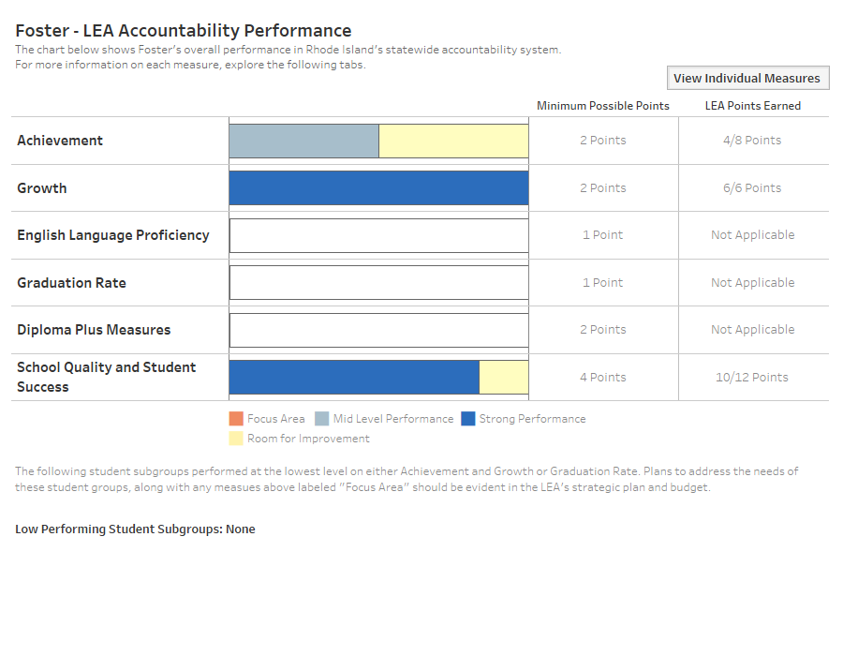
Foster
Confidential Working Document Draft §RIGL 38-2-2(4)(E),(K)

Slide 31
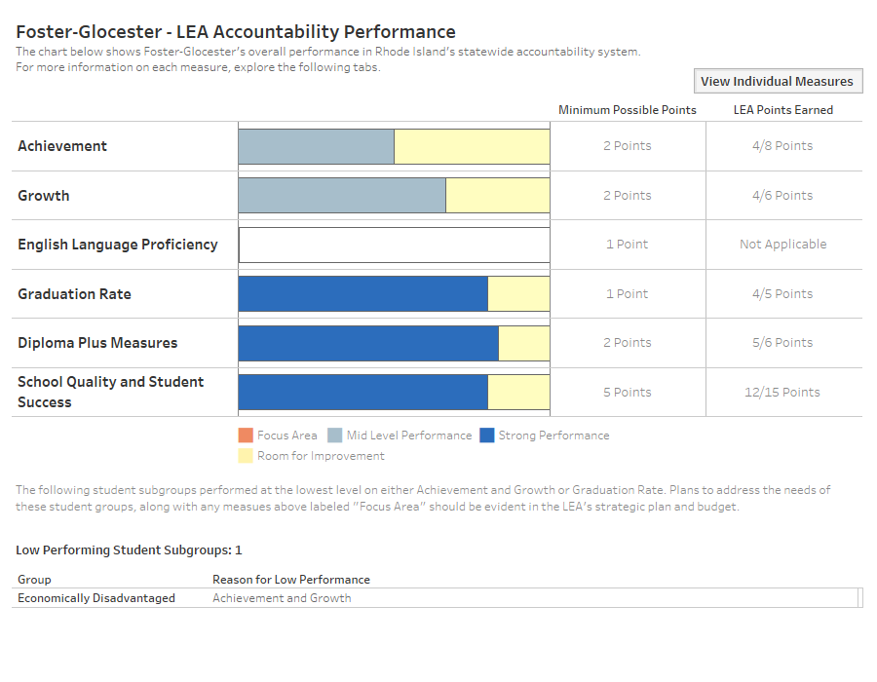
Foster-Glocester
Confidential Working Document Draft §RIGL 38-2-2(4)(E),(K)

Slide 32
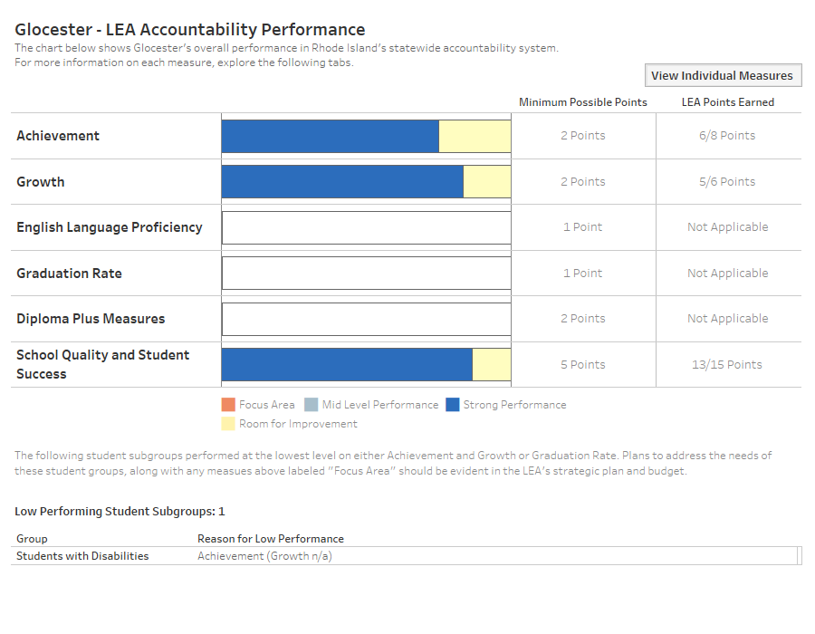
Glocester
Confidential Working Document Draft §RIGL 38-2-2(4)(E),(K)

Slide 33
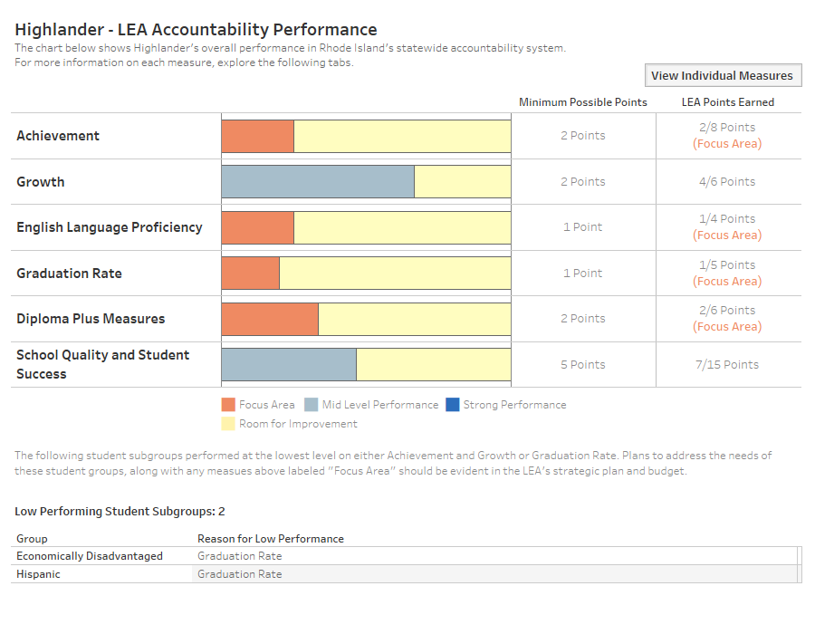
Highlander
Confidential Working Document Draft §RIGL 38-2-2(4)(E),(K)

Slide 34
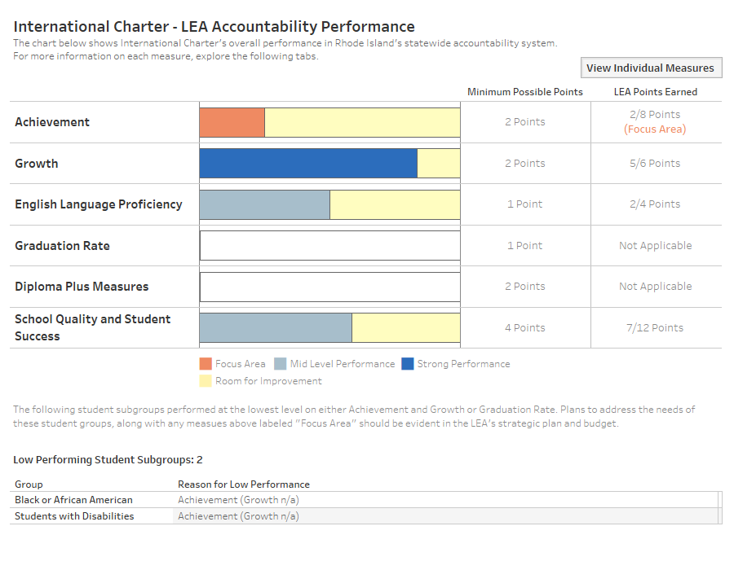
International Charter
Confidential Working Document Draft §RIGL 38-2-2(4)(E),(K)

Slide 35
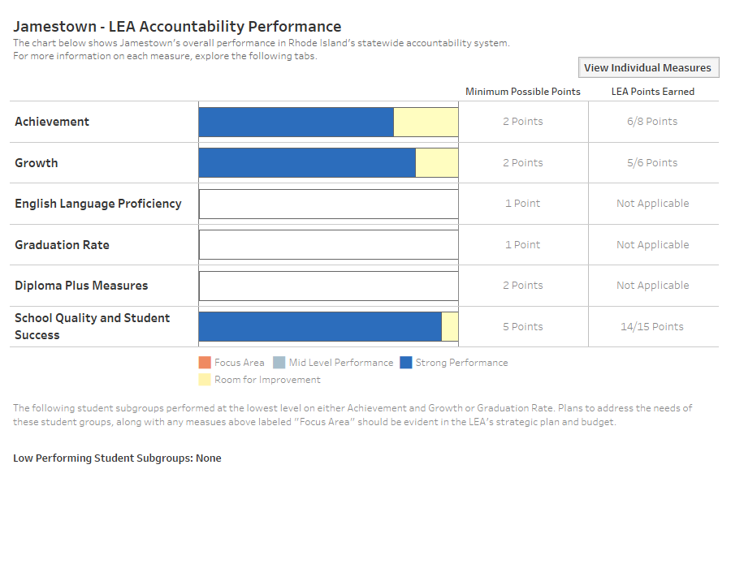
Jamestown
Confidential Working Document Draft §RIGL 38-2-2(4)(E),(K)

Slide 36
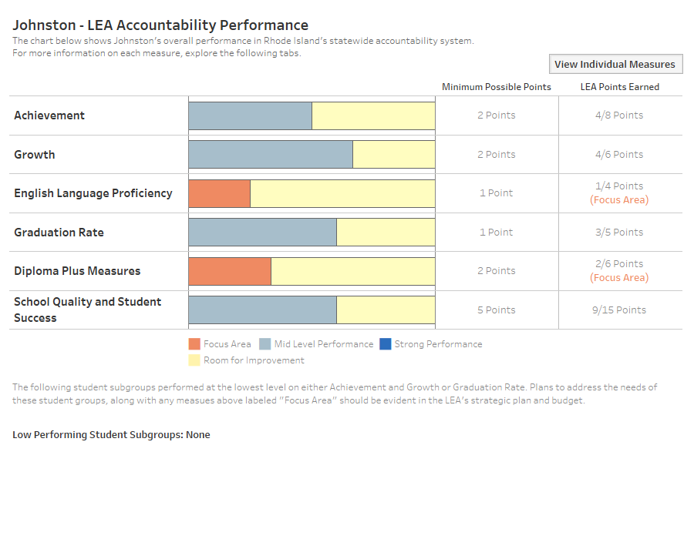
Johnston
Confidential Working Document Draft §RIGL 38-2-2(4)(E),(K)

Slide 37
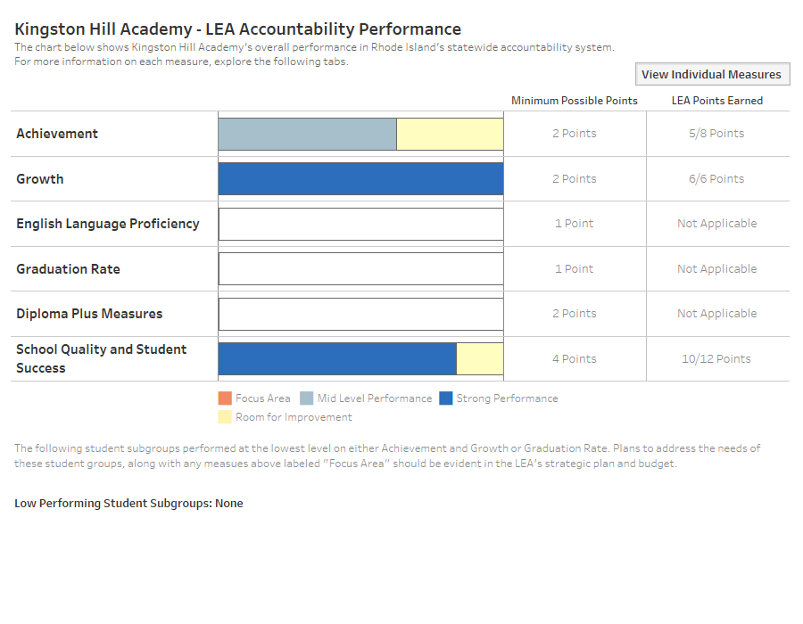
Kingston Hill Academy
Confidential Working Document Draft §RIGL 38-2-2(4)(E),(K)

Slide 38
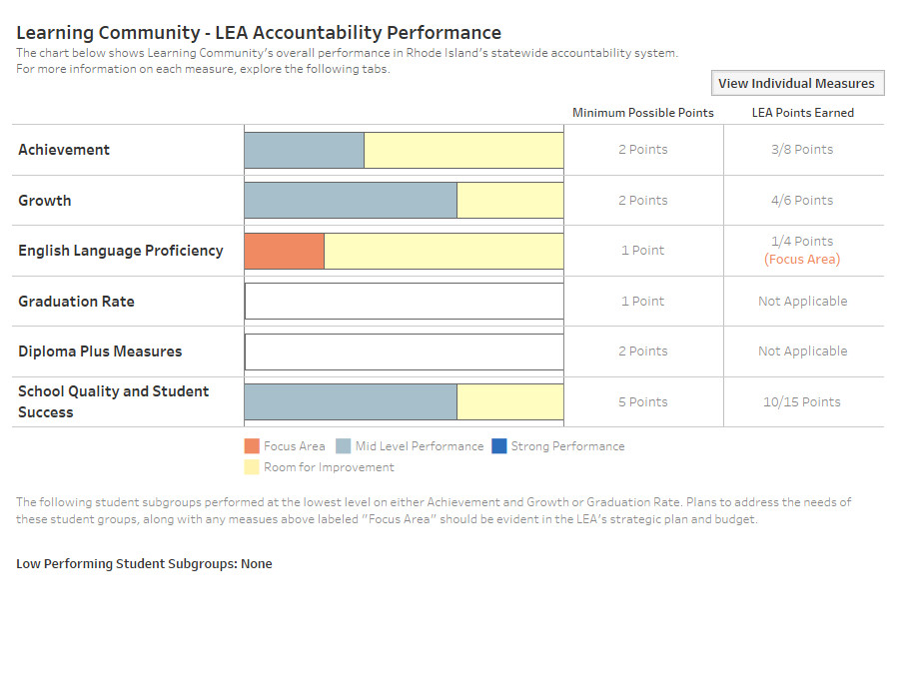
Learning Community
Confidential Working Document Draft §RIGL 38-2-2(4)(E),(K)

Slide 39
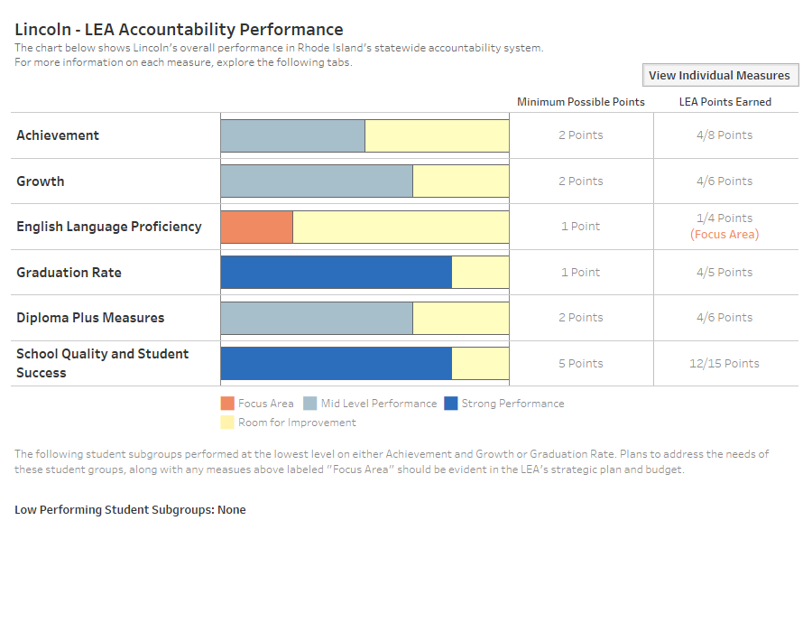
Lincoln
Confidential Working Document Draft §RIGL 38-2-2(4)(E),(K)

Slide 40
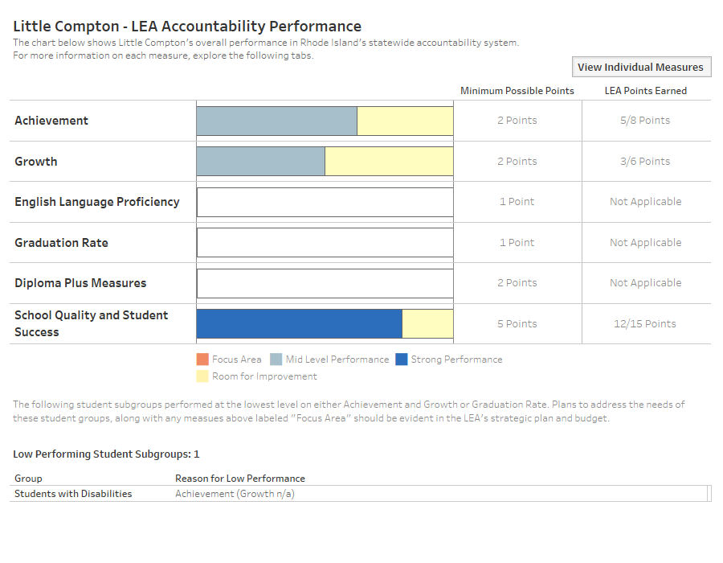
Little Compton
Confidential Working Document Draft §RIGL 38-2-2(4)(E),(K)

Slide 41
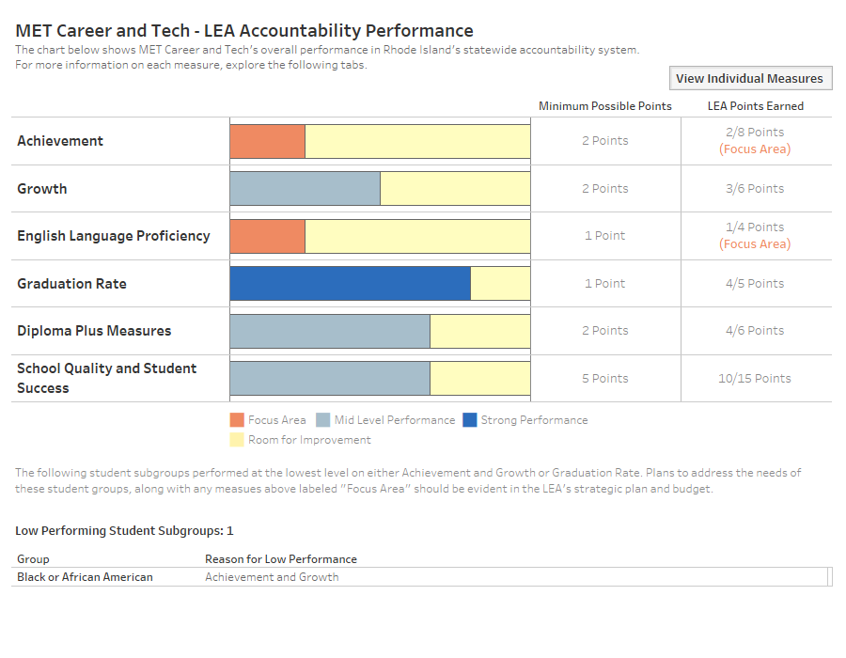
MET Career and Tech
Confidential Working Document Draft §RIGL 38-2-2(4)(E),(K)

Slide 42
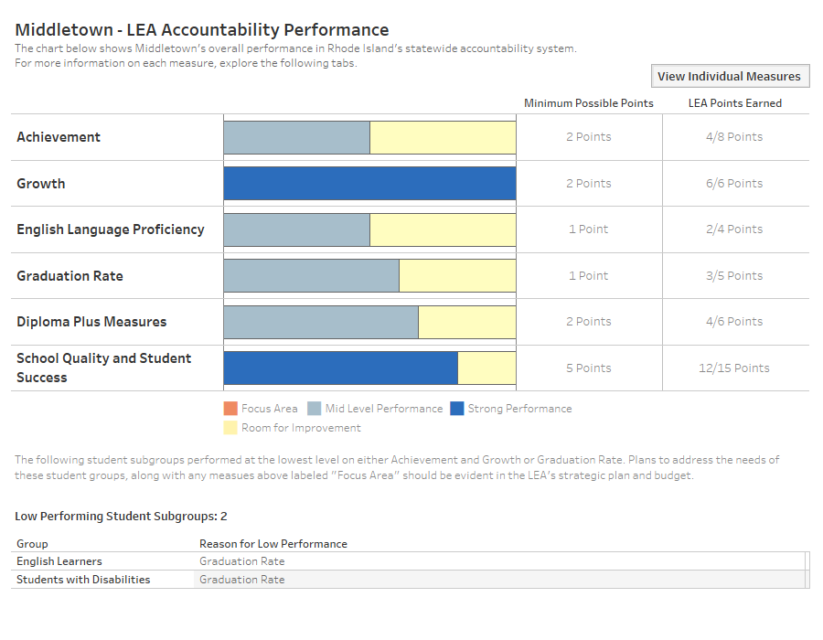
Middletown
Confidential Working Document Draft §RIGL 38-2-2(4)(E),(K)

Slide 43
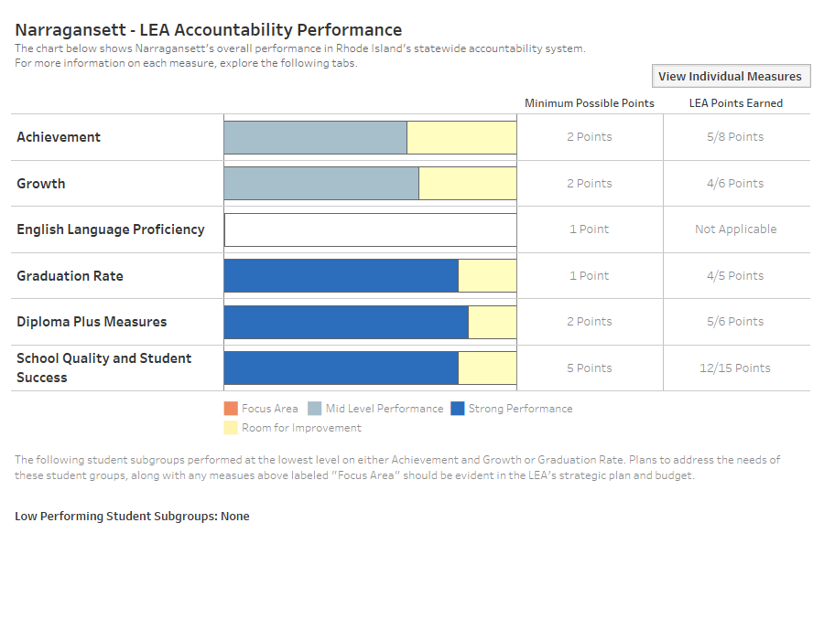
Narragansett
Confidential Working Document Draft §RIGL 38-2-2(4)(E),(K)

Slide 44
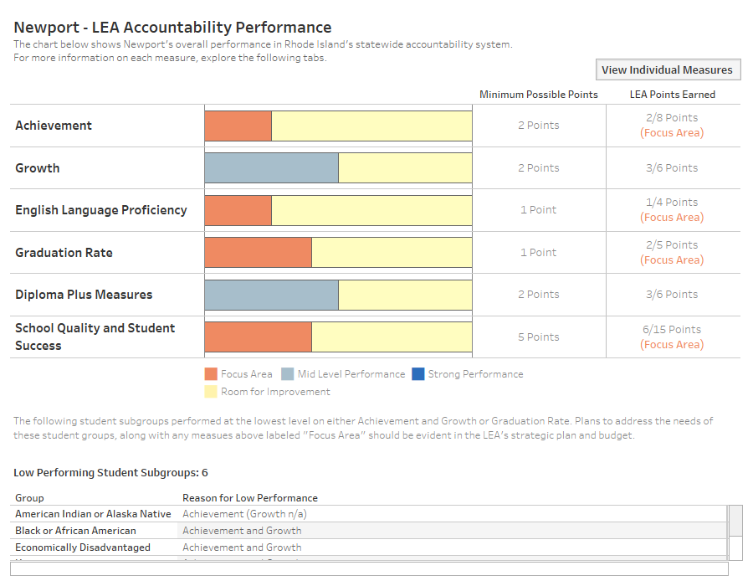
Newport
Confidential Working Document Draft §RIGL 38-2-2(4)(E),(K)

Slide 45
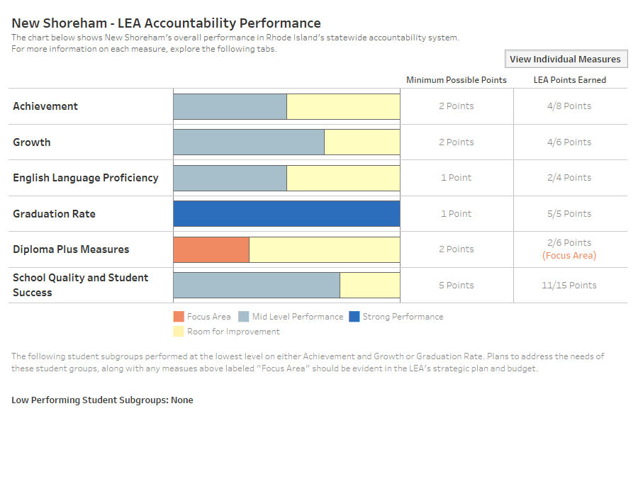
New Shoreham
Confidential Working Document Draft §RIGL 38-2-2(4)(E),(K)

Slide 46
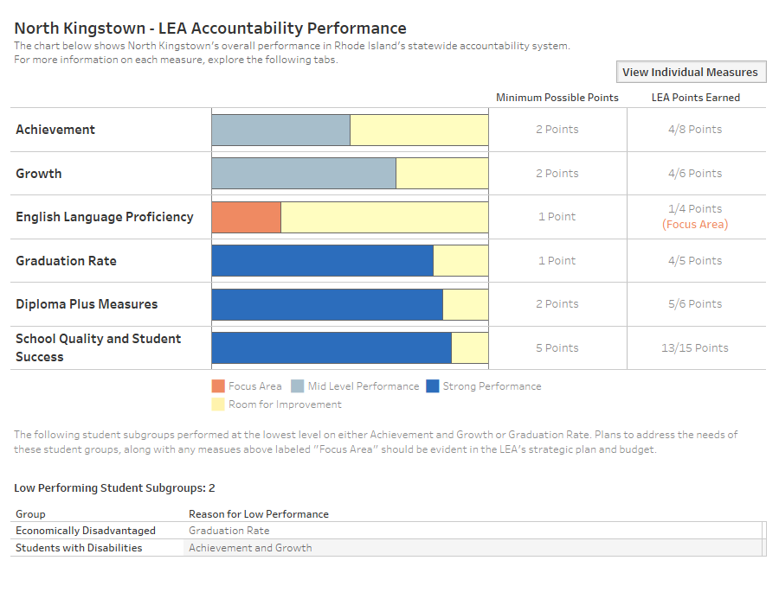
North Kingstown
Confidential Working Document Draft §RIGL 38-2-2(4)(E),(K)

Slide 47
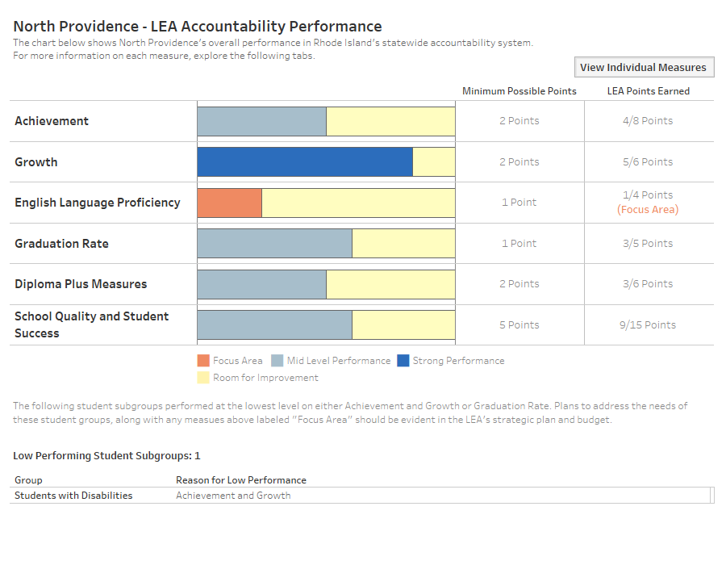
North Providence
Confidential Working Document Draft §RIGL 38-2-2(4)(E),(K)

Slide 48
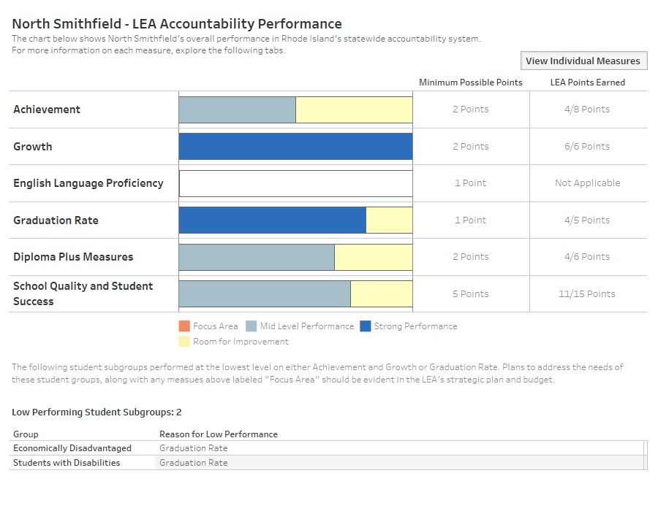
North Smithfield
Confidential Working Document Draft §RIGL 38-2-2(4)(E),(K)

Slide 49
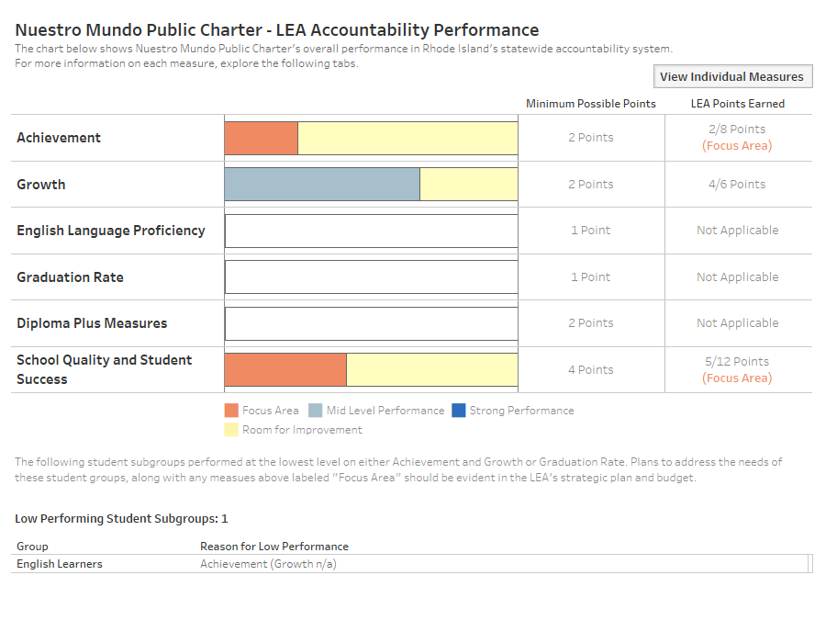
Nuestro Mundo Public Charter
Confidential Working Document Draft §RIGL 38-2-2(4)(E),(K)

Slide 50
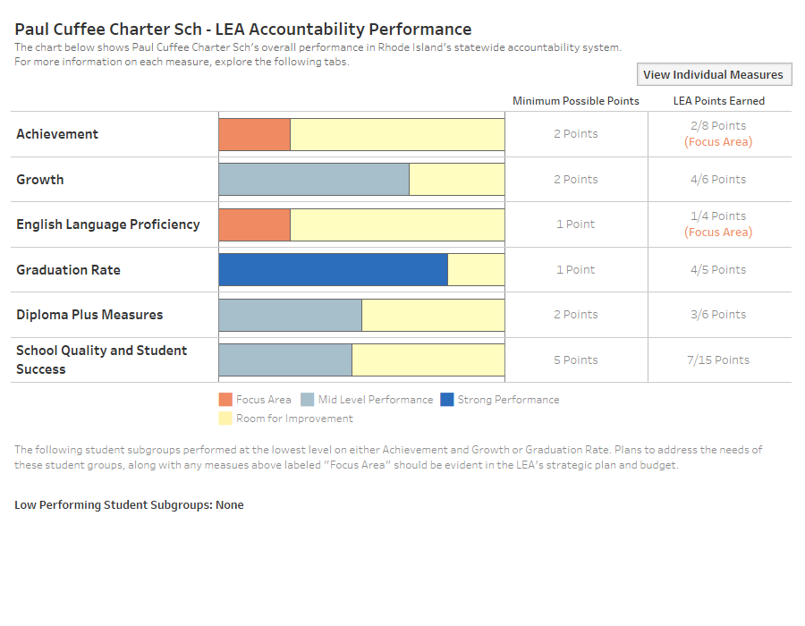
Paul Cuffee Charter School
Confidential Working Document Draft §RIGL 38-2-2(4)(E),(K)

Slide 51
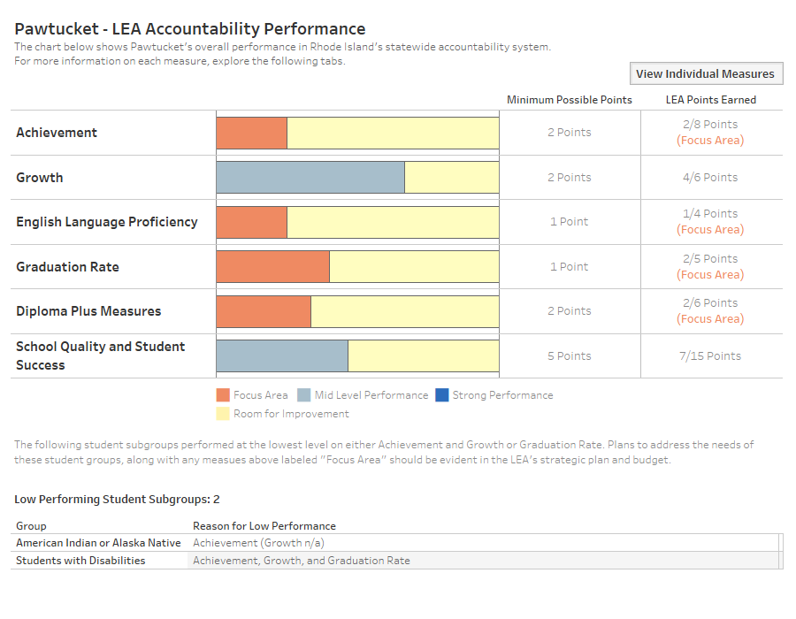
Pawtucket
Confidential Working Document Draft §RIGL 38-2-2(4)(E),(K)

Slide 52
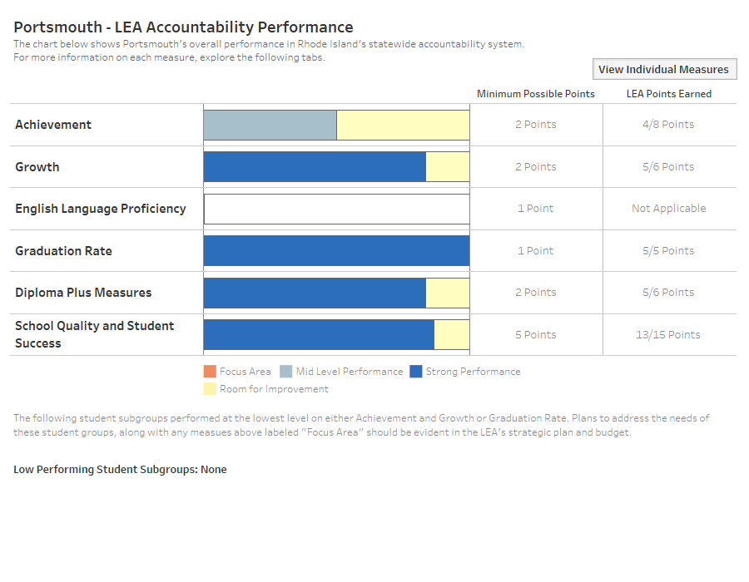
Portsmouth
Confidential Working Document Draft §RIGL 38-2-2(4)(E),(K)

Slide 53
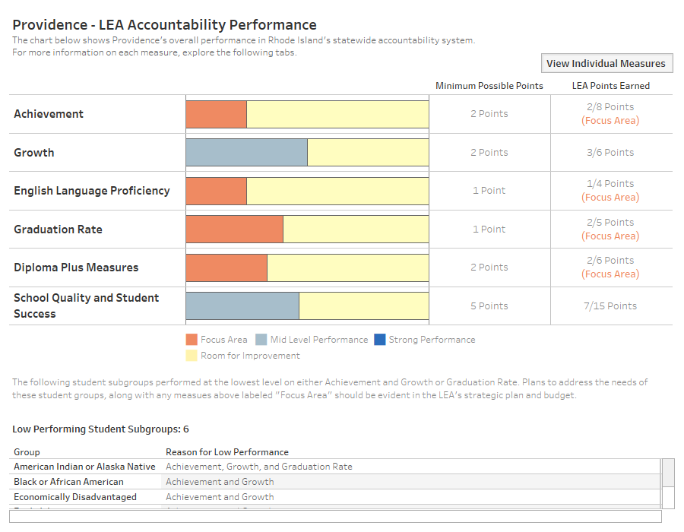
Providence
Confidential Working Document Draft §RIGL 38-2-2(4)(E),(K)

Slide 54
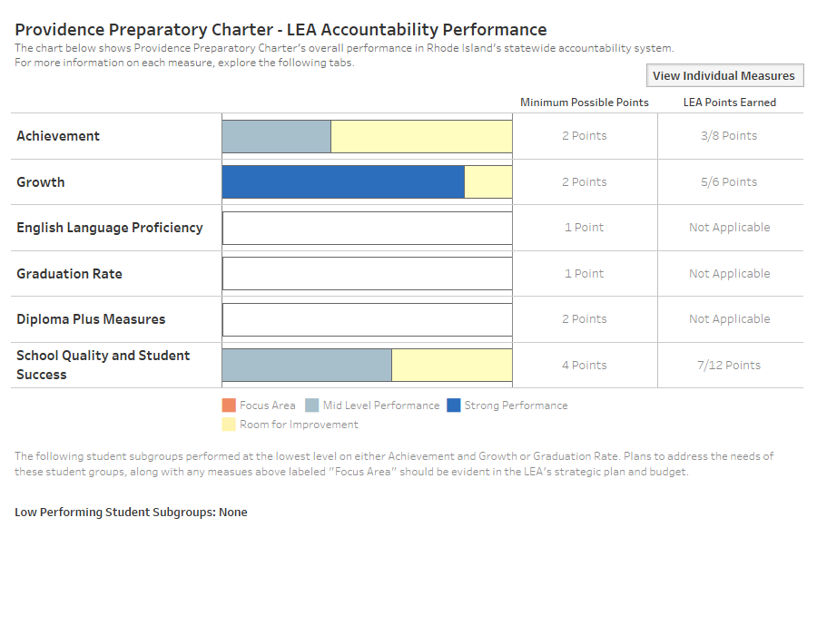
Providence Preparatory Charter
Confidential Working Document Draft §RIGL 38-2-2(4)(E),(K)

Slide 55
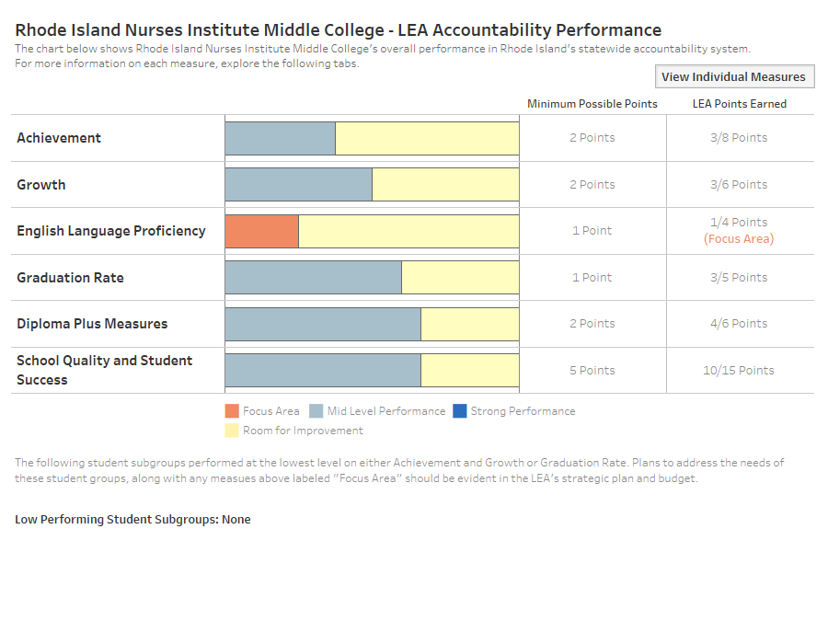
Rhode Island Nurses Institute Middle College
Confidential Working Document Draft §RIGL 38-2-2(4)(E),(K)

Slide 56
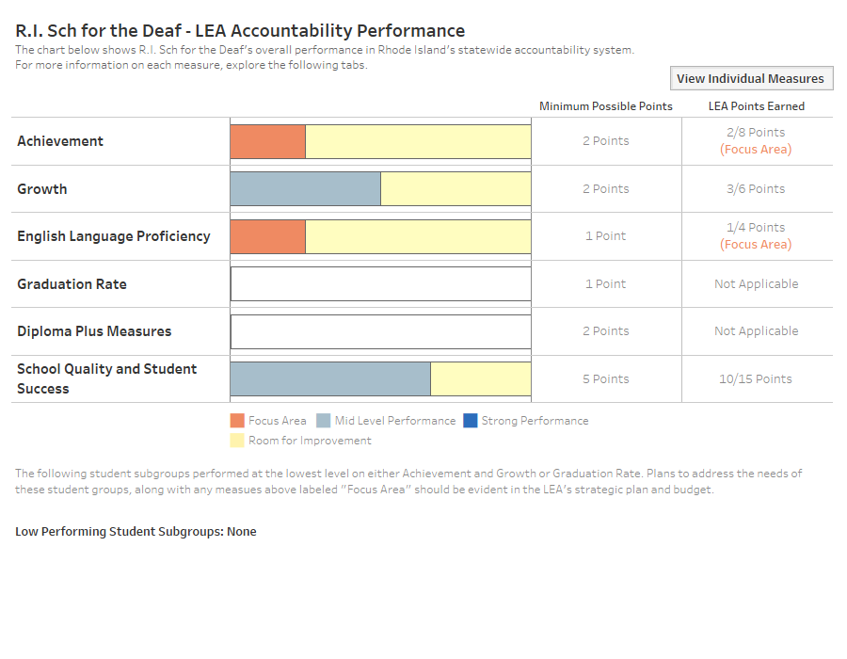
Rhode Island School for the Deaf
Confidential Working Document Draft §RIGL 38-2-2(4)(E),(K)

Slide 57
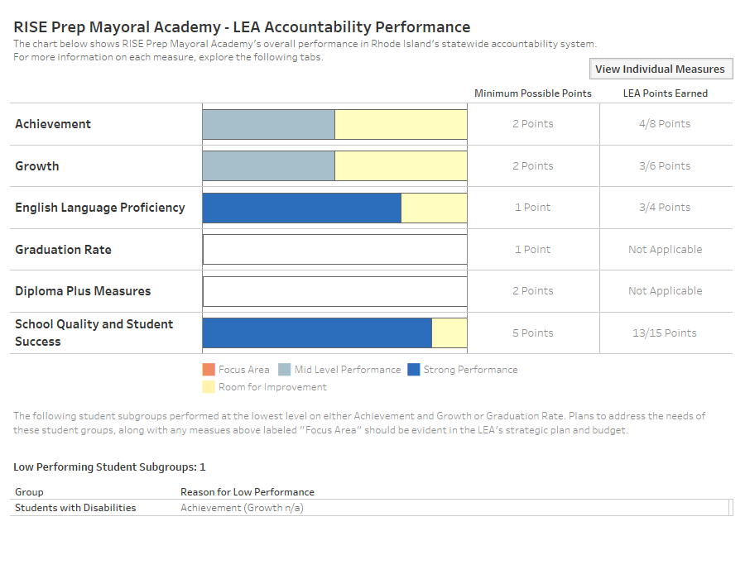
RISE Prep Mayoral Academy
Confidential Working Document Draft §RIGL 38-2-2(4)(E),(K)

Slide 58
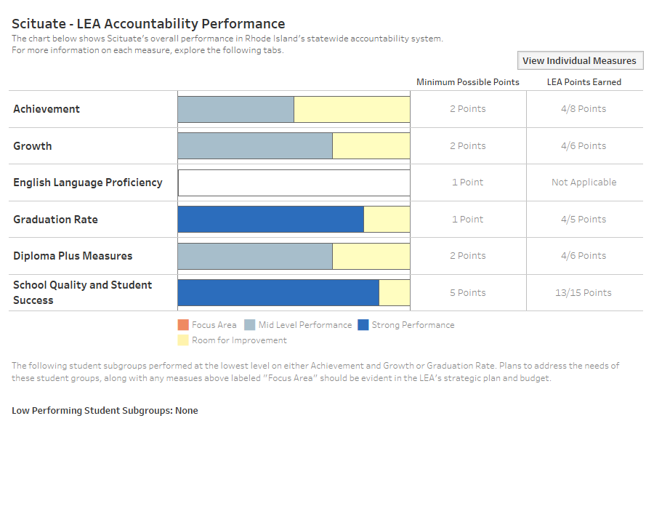
Scituate
Confidential Working Document Draft §RIGL 38-2-2(4)(E),(K)

Slide 59
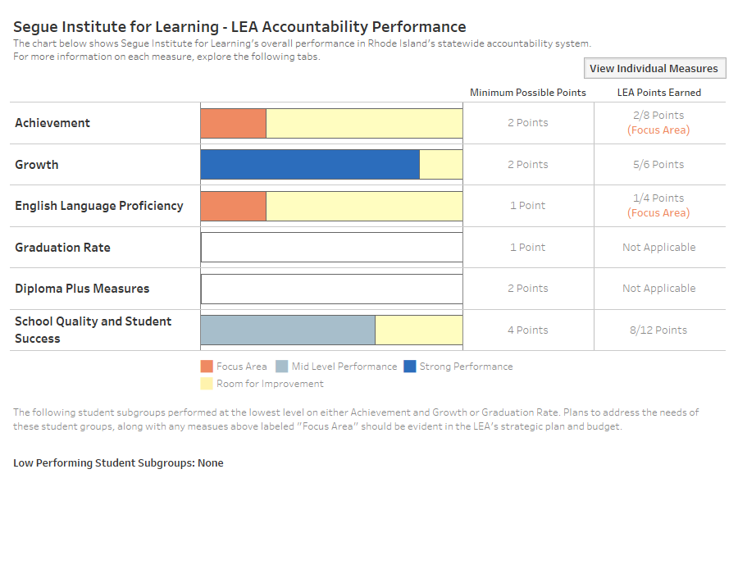
Segue Institute for Learning
Confidential Working Document Draft §RIGL 38-2-2(4)(E),(K)

Slide 60
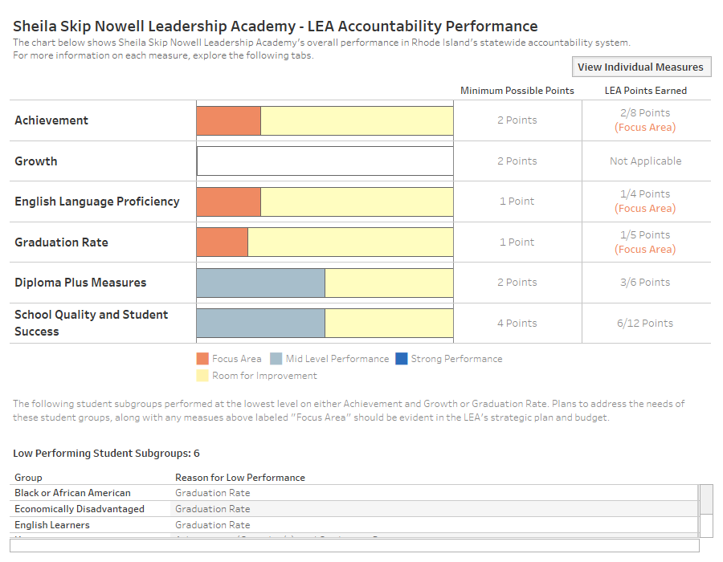
Sheila Skip Nowell Leadership Academy
Confidential Working Document Draft §RIGL 38-2-2(4)(E),(K)

Slide 61

Smithfield
Confidential Working Document Draft §RIGL 38-2-2(4)(E),(K)

Slide 62

South Kingstown
Confidential Working Document Draft §RIGL 38-2-2(4)(E),(K)

Slide 63

SouthSide Charter School
Confidential Working Document Draft §RIGL 38-2-2(4)(E),(K)

Slide 64

The Compass School
Confidential Working Document Draft §RIGL 38-2-2(4)(E),(K)

Slide 65

The Greene School
Confidential Working Document Draft §RIGL 38-2-2(4)(E),(K)

Slide 66

The Hope Academy
Confidential Working Document Draft §RIGL 38-2-2(4)(E),(K)

Slide 67

Tiverton
Confidential Working Document Draft §RIGL 38-2-2(4)(E),(K)

Slide 68

Trinity Academy for the Performing Arts
Confidential Working Document Draft §RIGL 38-2-2(4)(E),(K)

Slide 69

Urban Collaborative
Confidential Working Document Draft §RIGL 38-2-2(4)(E),(K)

Slide 70

Village Green Virtual
Confidential Working Document Draft §RIGL 38-2-2(4)(E),(K)

Slide 71

Warwick
Confidential Working Document Draft §RIGL 38-2-2(4)(E),(K)

Slide 72

Westerly
Confidential Working Document Draft §RIGL 38-2-2(4)(E),(K)

Slide 73

West Warwick
Confidential Working Document Draft §RIGL 38-2-2(4)(E),(K)

Slide 74

Woonsocket
Confidential Working Document Draft §RIGL 38-2-2(4)(E),(K)

